Slide 1
Profit prediction of companies using machine learning
By:
Anirudh Uday Parvatikar
Under guidance of:
Exposys data labs

Slide 2
Contents
Abstract
Introduction
Objective
Existing System
Proposed System
Modules
Conclusion

Slide 3
Abstract
This project is mainly aimed to test out our data analytical skills which has to be applied to solve any data science problem.
This project aims to predict company profit based on how much a company has invested in research, administration, marketing.
This internship aims to contribute into the financial sector by presenting innovative data driven approach for predicting profits for any given company.
This model can be used by any company in their financial analytics, investors and corporate stratergies to enhance their decision making process.

Slide 4
introduction
It is important in today’s market to stay ahead of the competition and estimate their profits for a product before it’s been launched, this helps them to use resources they have at their disposal efficiently.
In recent times technology is evolving at faster pace and data is being generated everywhere, company’s make use of these largely generated data for their advantage like: making future prediction about their product, understanding their customers etc…
The dataset that is used in this project comprises of historical financial data, market trends & other economic indicators. These variables shape company’s financial performance and are important for accurate profit prediction.

Slide 5
Objective
The objective of the ML model is to develop a predictive model that can accurately forecast the profit value of a company.
The important aspect is to identify parameter on which the model will predict the profit, some of the parameters identified are: R&D spend, administration cost & marketing spend.
Additionally, the objective is to create a user-friendly and scalable solution that can be easily adopted by businesses of all sizes and industries.

Slide 6
Existing system
The existing system primarily relies on traditional methods to estimate profit for any organization.
As these are traditional methods, given some new scenarios they won’t perform as expected to current requirement. This can be due to the complex data that is being produced in day-to-day lives.
Traditional methods struggle to account for non-linear relationships in any given data, sudden shift in market trends, impact of internal and external factors for the company.
Further more these traditional methods may not fully utilize the vast data that is being generated in the recent times therefore we might not be able to predict accurate results.

Slide 7
Proposed system
The proposed system is an ML model that utilizes mainly 2 algorithms: Linear Regression & Random Forest Regressor.
The proposed system addresses the drawbacks of the traditional methods by incorporating more accurate and efficient algorithm for prediction.
The model is then evaluated for accuracy by rigorously testing it with test data and comparing the predicted values with actual values.
The stages that ML model undergoes are: Feature selection, Data pre-processing, Model selection, Cross-validation.

Slide 8
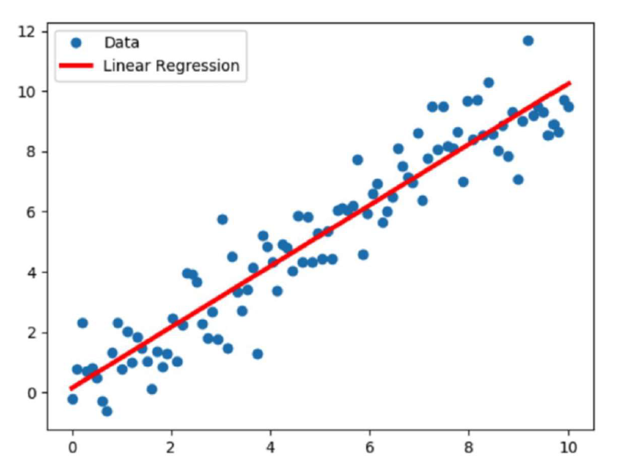
modules
Linear Regression:
Linear regression is a statistical modeling technique used to establish a relationship between dependent variable and one or more independent variables.
In linear regression model, the dependent variable is assumed to be linear function of independent variables.
The objective of this model is to predict the value of the dependent variable based on the values of the independent variables.
Linear regression fits a straight line that minimizes discrepancies between the predicted and actual output values.

Slide 9
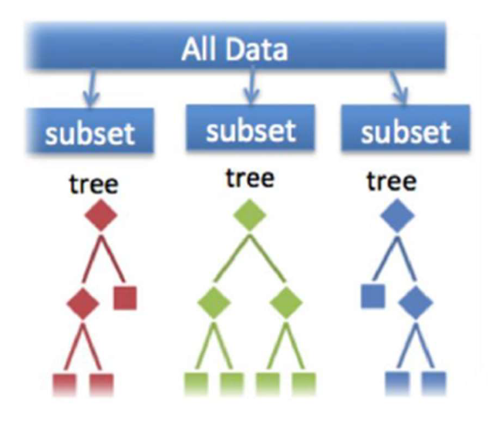
Modules contd…
Random Forest Trees:
Random forest consists of large number of individual decision trees that operate as an ensemble method.
Each individual tree in the random forest splits out a class prediction and the class with most votes becomes our model’s prediction.
Random forest are based on 2 key concepts names “Bagging” and “feature selection”.
The key principle underlying the random forest approach comprises the construction of many “simple” trees in training stage and majority vote is taken for the output.

Slide 10
Implementation
To get started download the codebase from the github.com/anirudhp06/Company-Profit-Prediction
The folder will consist of “requirements.txt” text file, by using pip install all the dependencies `pip install –r requirements.txt`
Once all dependencies are installed open the jupyter notebook by command `jupyter notebook`
If you have any changes to make you can freely make them.
To start with prediction we need to use streamlit library.
In terminal execute the command `streamlit run app.py` this will open new browser window and there we can start predicting.

Slide 11
Implementation contd…
Further we can make changes to the `app.py` file according to our requirements.
Streamlit enables user to have web user interface for machine learning programs.
It is very easy to use.
We can also host the streamlit application on cloud providers like Amazon AWS, Google Cloud Platform, Microsoft Azure, etc…
Streamlit enables developers to distribute the AI models easily to their clients.

Slide 12
conclusion
The incorporation of diverse set of features, including financial metrics, & market trends allowed for comprehensive representation of company’s operational environment.
This enhanced dataset provided the model with valuable insights, enabling it to discern intricate patterns & relationships that traditional methods may have missed.
The evaluation of multiple machine learning algorithms demonstrated the advancement of technology and helped us in choosing right model for predicting profit with good accuracy.
In conclusion, this project provides powerful model for business and investors for assisting them in making important decisions for their respective institutions.

